Slide 1
Ray Tracing in Entertainment Industry
Tanaboon Tongbuasirilai
Dept. Computer Science
Kasetsart University
Week 8
Reflection models and indirect illuminations

Slide 2
Classifications of BRDF models
Empirical BRDF
Early stage of shader development.
Mathematically derived the light scattering behaviors.
Model parameters are mathematical relations.
Analytical BRDF
Physically based derivation.
Model parameters are related to the material physical properties.
Data-driven BRDF
Measured BRDFs are becoming popular.
Model parameters are relied on the data-driven methods.
Notes:
History and overview of each class of BRDF models.

Slide 3
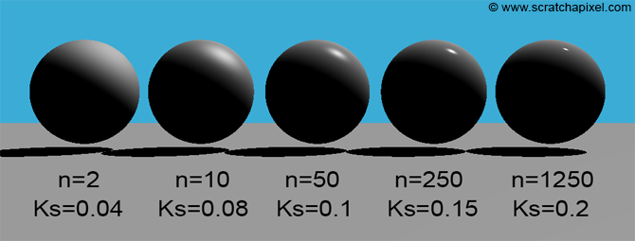
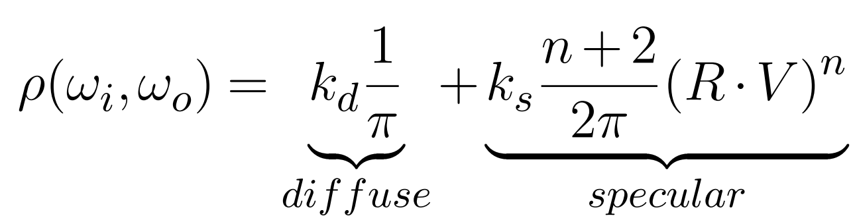
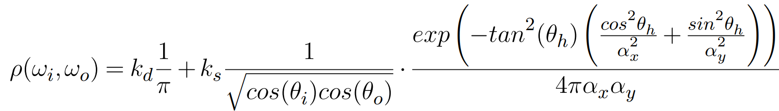
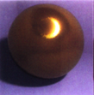
BRDF model – The empirical model
Empirical BRDF model
Phong BRDF model
Ward BRDF model

Slide 4
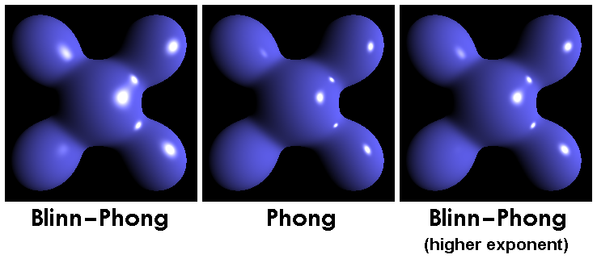
Empirical BRDFs
Lambertian
Phong
Blinn-Phong
Ward
Oren-Nayar
en.wikipedia.org/wiki/Blinn–Phong_reflection_model
Notes:
Show Blinn-Phong and Oren-Nayar models

Slide 5
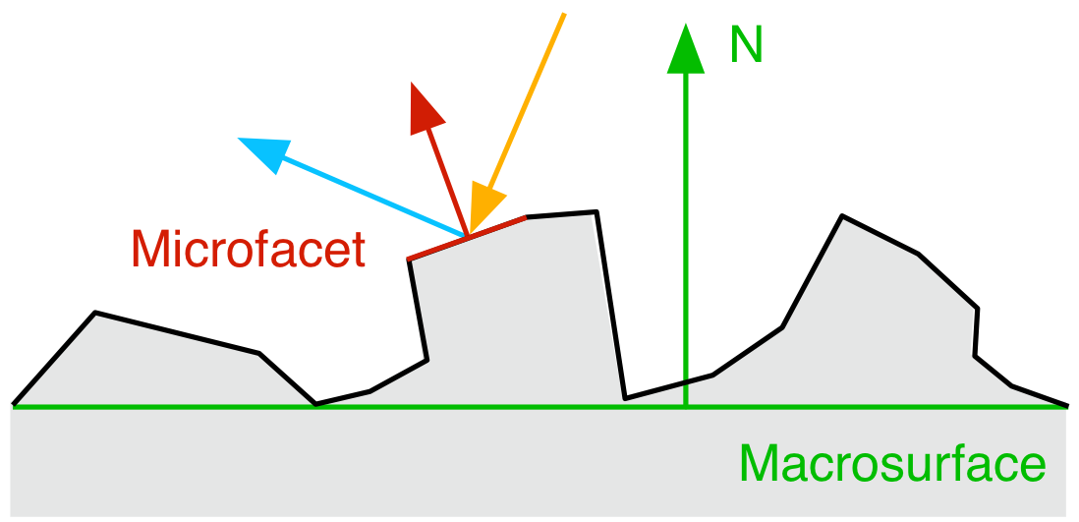
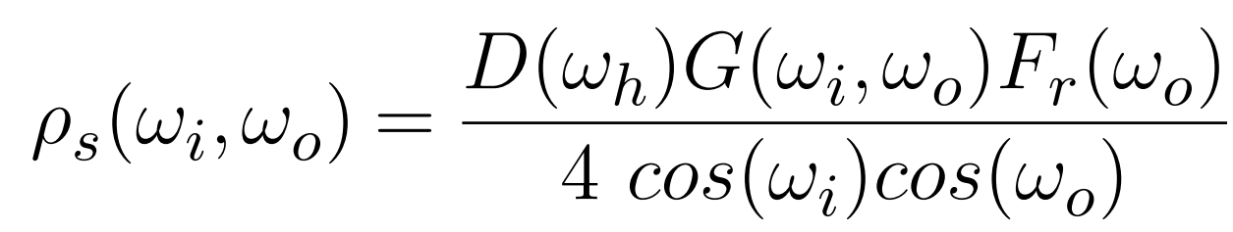
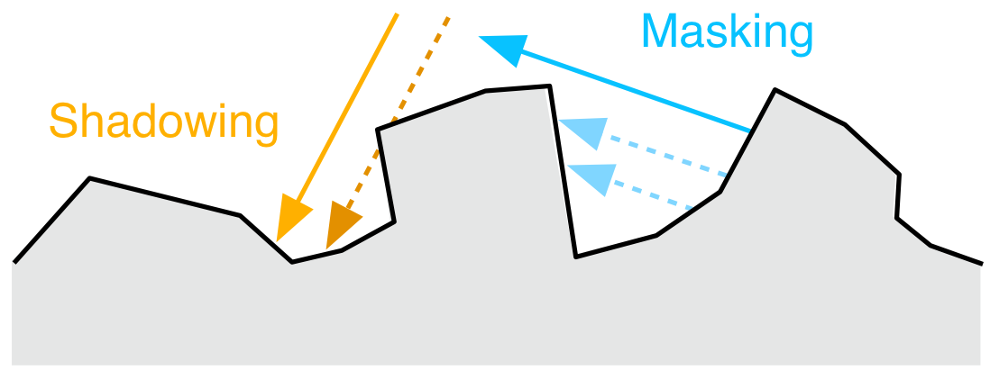
BRDF model – The analytical model
Analytical BRDF model
- The microfacet BRDF model
Romain Guy and Mathias Agopian, Physically Based Rendering in Filament, https://google.github.io/filament/Filament.html
Notes:
Describe each term

Slide 6
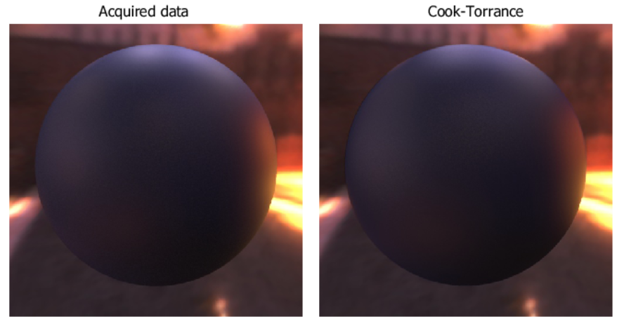
Analytical BRDFs
Cook-Torrance
GGX
ABC model
http://people.csail.mit.edu/addy/research/brdf/brdf.ps.web/slide18.html
Notes:
Show equation of each model.
Show acquired data

Slide 7
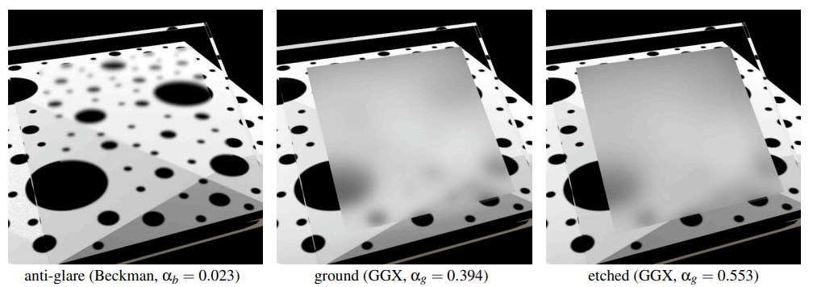
BRDF for refraction
cs.cornell.edu/~srm/publications/EGSR07-btdf.pdf

Slide 8
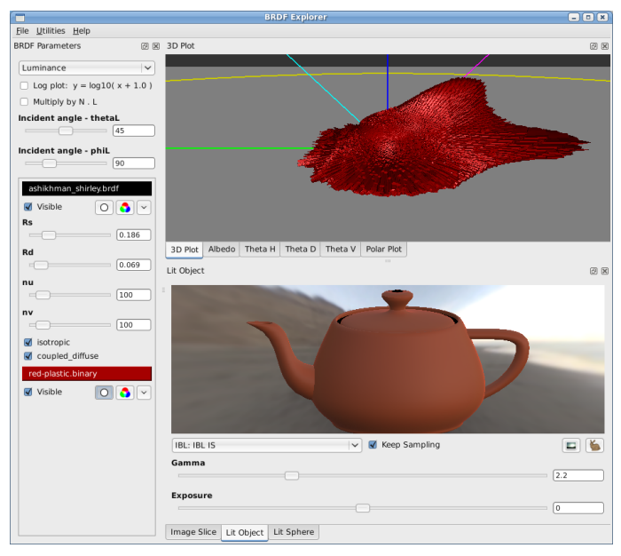
Physically-based shading at Disney
media.disneyanimation.com/uploads/production/publication_asset/48/asset/s2012_pbs_disney_brdf_notes_v3.pdf

Slide 9
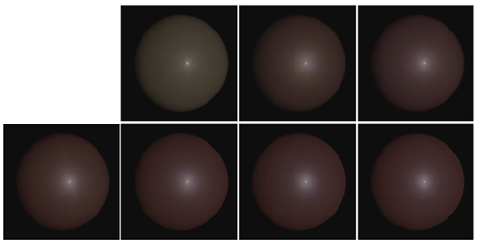
BRDF model – The data-driven model
Data-driven BRDF model
- Principal Component Analysis (PCA)
N = 5
N = 10
N = 20
N = 30
N = 45
N = 60
Reference

Slide 10
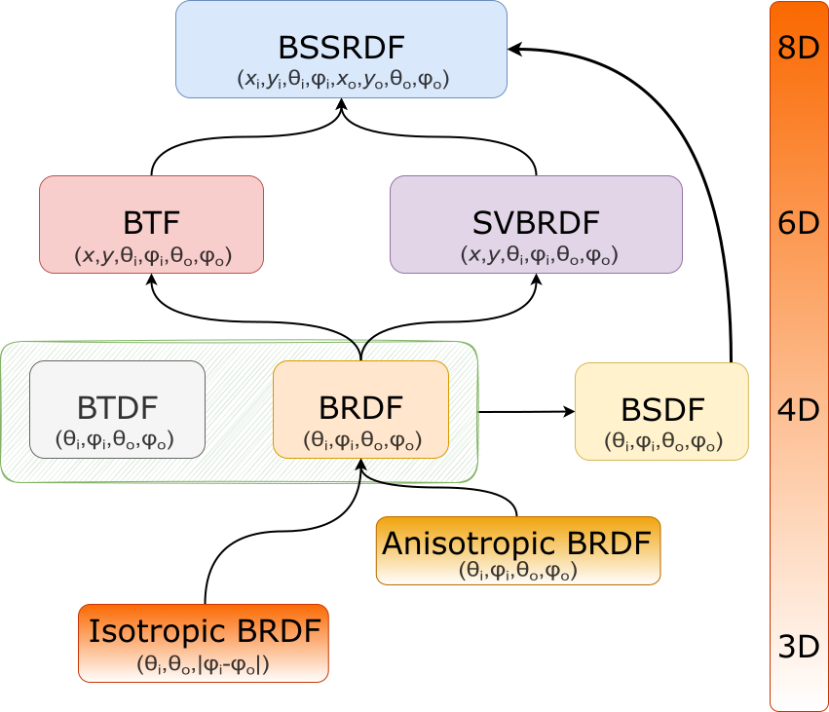

A taxonomy of reflectance functions

Slide 11
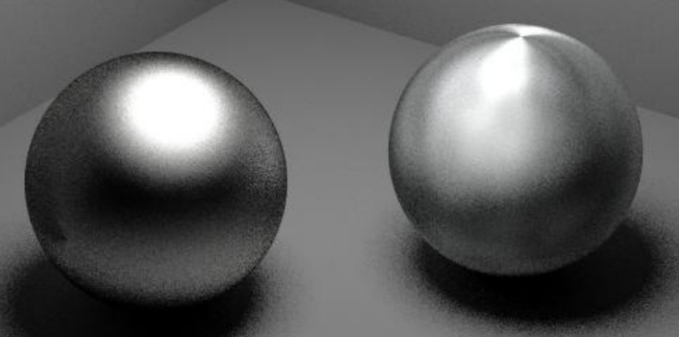
Isotropic vs anisotropic BRDFs
Isotropic materials show the same properties in all directions.
Anisotropic materials show different properties in different directions
Notes:
Class discussion on isotropic vs anisotropic

Slide 12
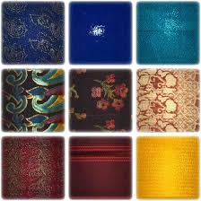
SVBRDF – Spatially varying BRDF
cg.cs.uni-bonn.de/btf/bonn_svbrdf_database.html
Notes:
Show bonn dataset

Slide 13
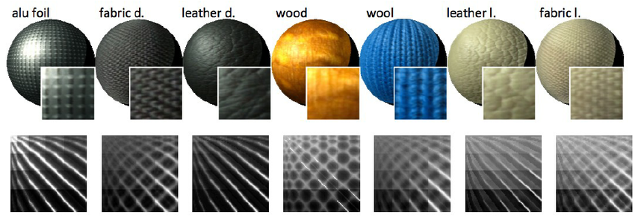
BTF – Bidirectional Texture Function
researchgate.net/figure/Material-samples-used-in-the-study-represented-as-BTF-data-Second-row-sh-ows-materials_fig1_258120939
Notes:
Show bonn dataset and acquisition setup

Slide 14
Challenges in BRDF modeling
Accurate representation
Accuracy for novel view synthesis, rendering.
Efficient representation
The model is low cost both in storage needed and computation.
Intuitive for editing (optional)

Slide 15
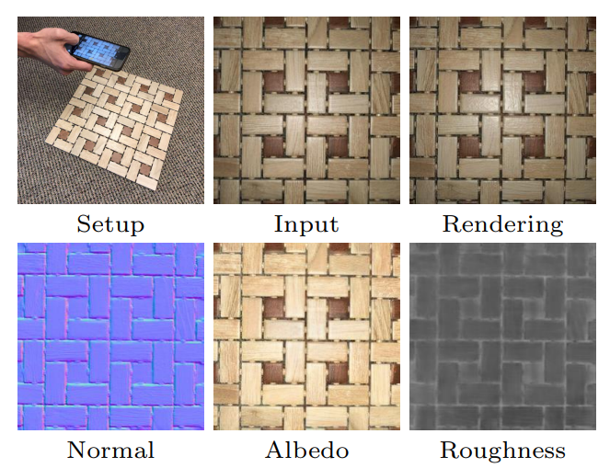
A.I. in material estimations : Materials for Masses

Slide 16
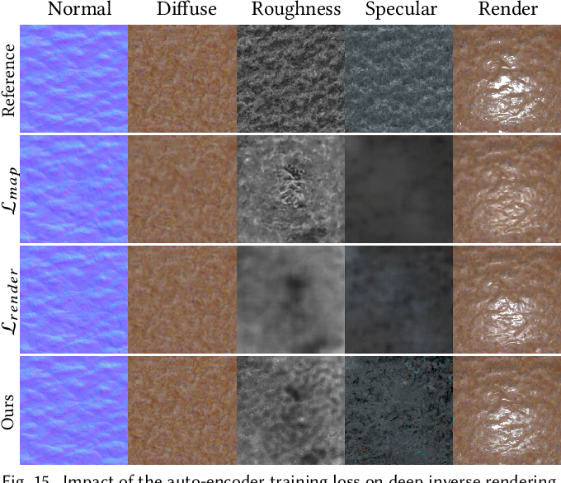
A.I. in material estimations : Deep inverse rendering for high-resolution SVBRDF estimation from an arbitrary number of images

Slide 17
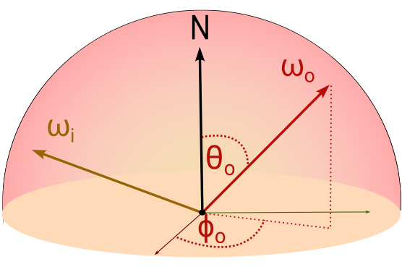
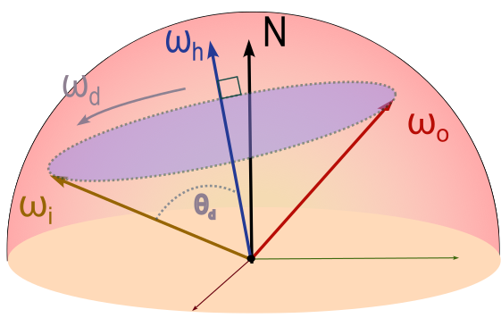
BRDF parameterization
Spherical coordinates
(Standard parameterization)
Rusinkiewicz [1998]
(Half-Diff parameterization)

Slide 18
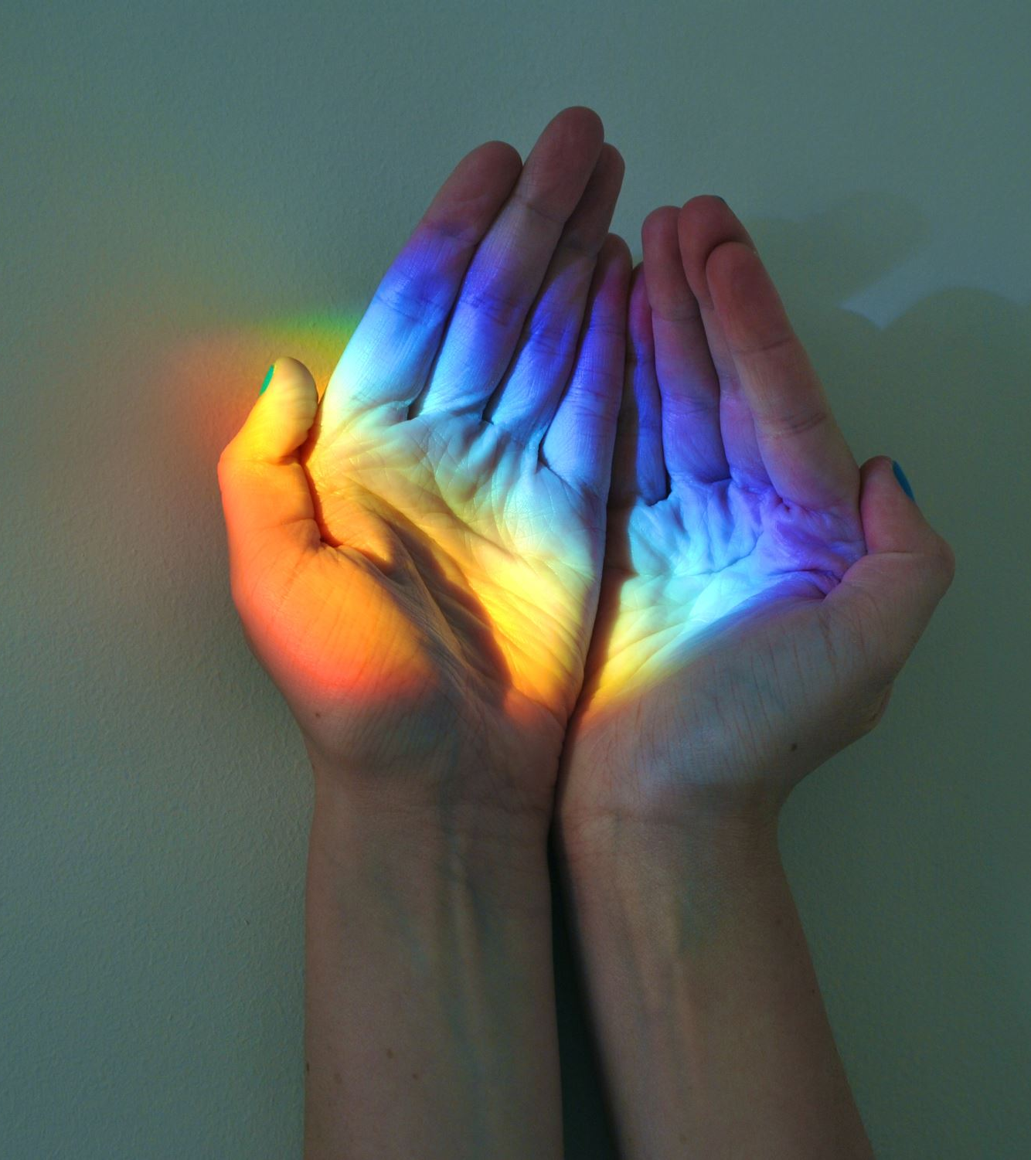
BRDF method
We separate scattering method and BRDF method.
scattering method defines how the ray is scattered, reflected.
BRDF method defines how much light is reflected depending on the incoming and outgoing angles (viewing and light directions).
Notes:
Previously we mixed up scattered directions and reflectance values.

Slide 19
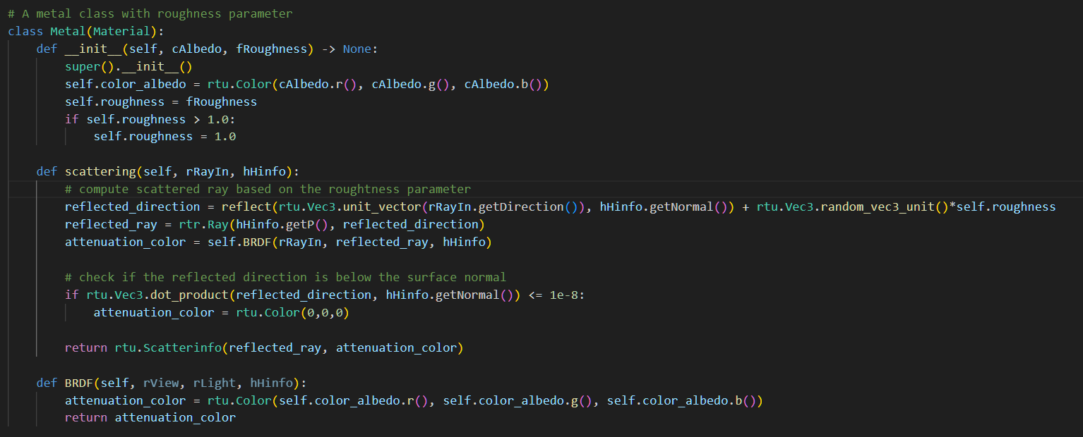
Example

Slide 20
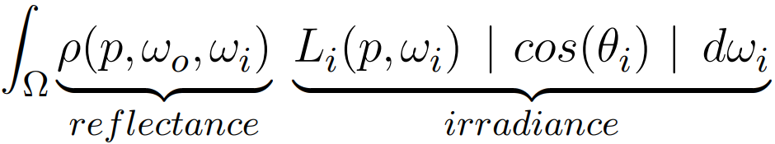
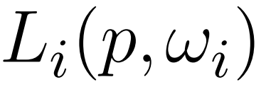
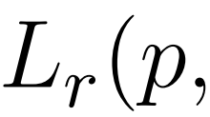


Notes:
Reverse process of this illustration.

Slide 21
Direct lighting term
Le
Sampled ray
theta_{Le}
Radiance from Le : BRDF * Le * cos(theta_{Le})
Radiance from sampled ray
Viewing direction

Slide 22
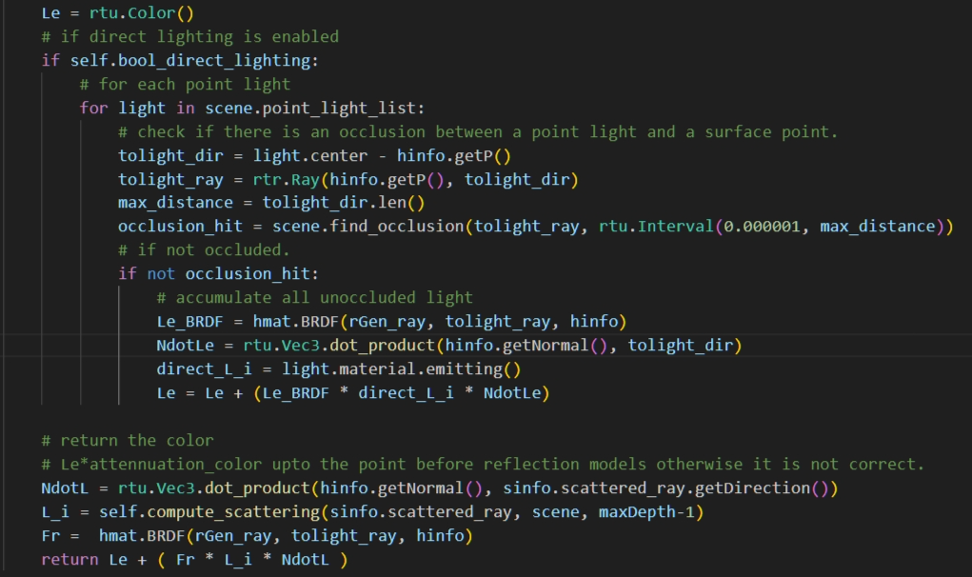
Direct lighting changed

Slide 23
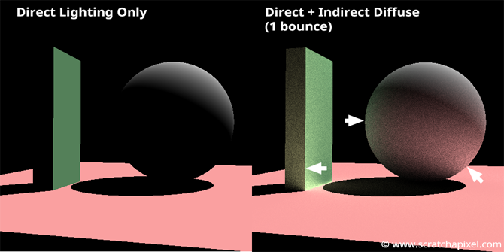
Indirect illumination
What effects do we obtain when our renderer can account for indirect lighting ?
How do we simulate the indirect lighting ?
www.scratchapixel.com/lessons/3d-basic-rendering/global-illumination-path-tracing/global-illumination-path-tracing-practical-implementation.html
Notes:
Starting to think about ray tracer handling indirect illumination.
Previously we obtain indirect lighting automatically.
We have written one type of ray tracer.

Slide 24
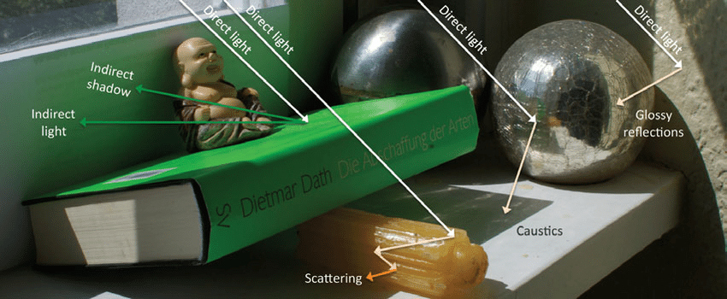
Lighting effects
Rauwendaal, Randall. (2013). Voxel Based Indirect Illumination using Spherical Harmonics. 10.13140/2.1.1300.6403.
Notes:
Some renderers can render caustics but some are not.
Some renderers can render color bleeding effect.

Slide 25
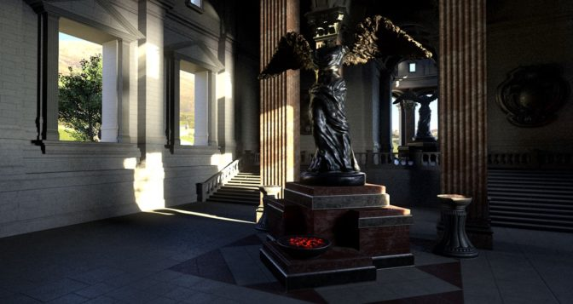
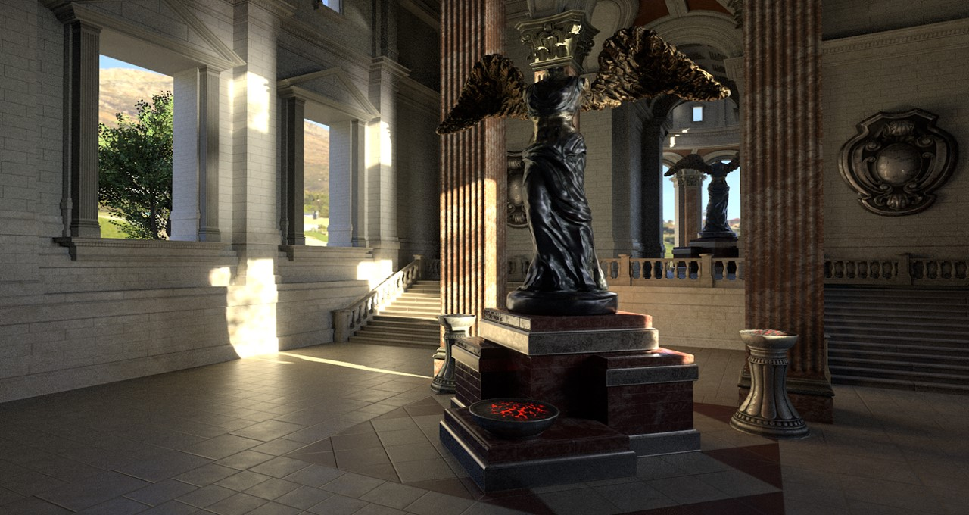

Indirect lighting effects
https://blogs.nvidia.com/blog/2022/08/04/direct-indirect-lighting/
Notes:
Can our ray tracer in class render this indirect lighting ?
It’s hard to sample where the region needs to be focused on indirect lighting because of random scattering.

Slide 26
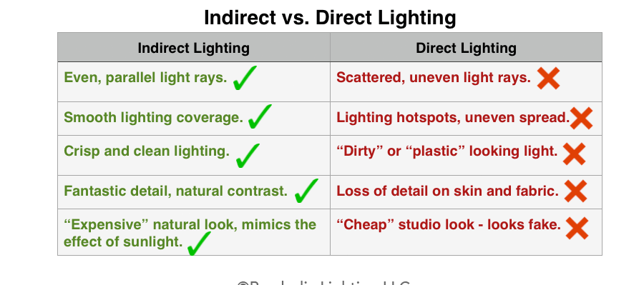
Photography perspectives
https://www.parabolixlight.com/indirect-vs-directlighting
Notes:
Indirect lighting looks expensive on both quality and computational complexity.

Slide 27

Solving for indirect illumination
It means we have to find an integrator such that it accounts for the indirect illumination.
The first week we covered types of global illumination solver.
Ray tracing
Radiosity
Photon mapping
In this course, we focus on ray tracing.
The integrator is an important key to render photo-realistic images.

Slide 28
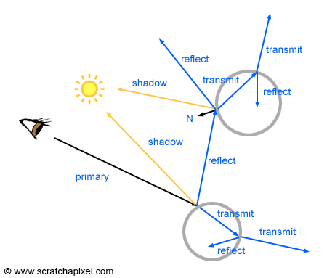
Whitted Ray Tracing
Only 1 ray per pixel !
www.scratchapixel.com/lessons/3d-basic-rendering/ray-tracing-overview/light-transport-ray-tracing-whitted.html
Notes:
Types of ray tracing

Slide 29
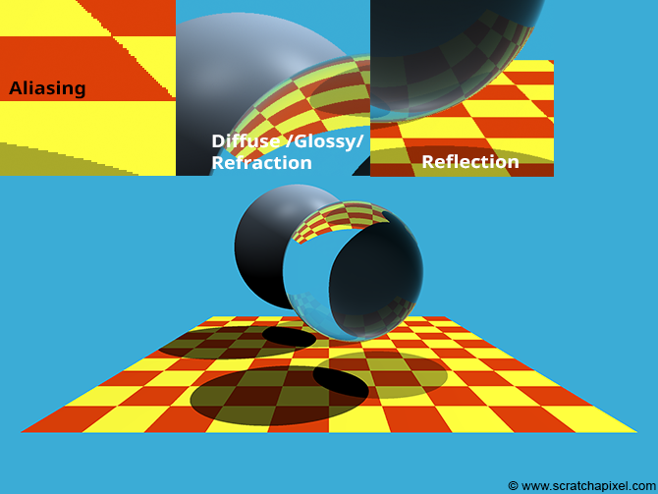
Result

Slide 30
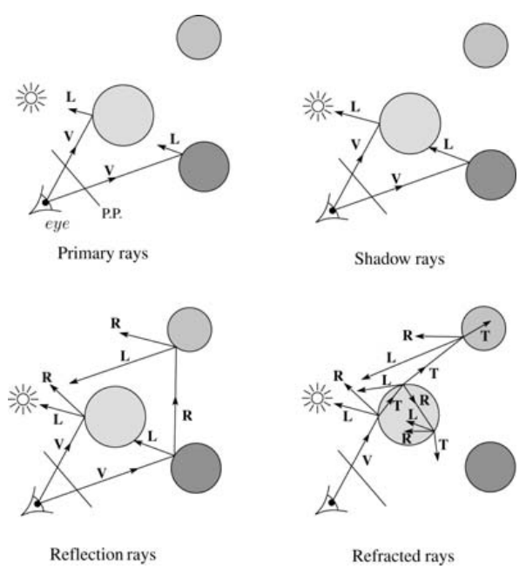
Algorithm
For each pixel, shoot a primary ray in direction V to the first visible surface.
For each intersection, trace secondary rays
Shadow rays in direction L, to light sources
Reflected ray in direction R.
Refracted ray or transmitted ray in direction T.
courses.cs.washington.edu/courses/cse457/11au/lectures/markup/ray-tracing-markup.pdf
Notes:
Primary ray
Shadow ray
Reflection
Refraction

Slide 31

Indirect illumination with the Whitted ray tracing ?
It’s very limited to account for indirect illumination.
One ray per pixel.
Only perfect reflection.
The following idea came after the Whitted ray tracing to account for more integration domains.
Distributed ray tracing, Distribution ray tracing, Stochastic ray tracing
Unbiased path tracing, Path tracing

Slide 32
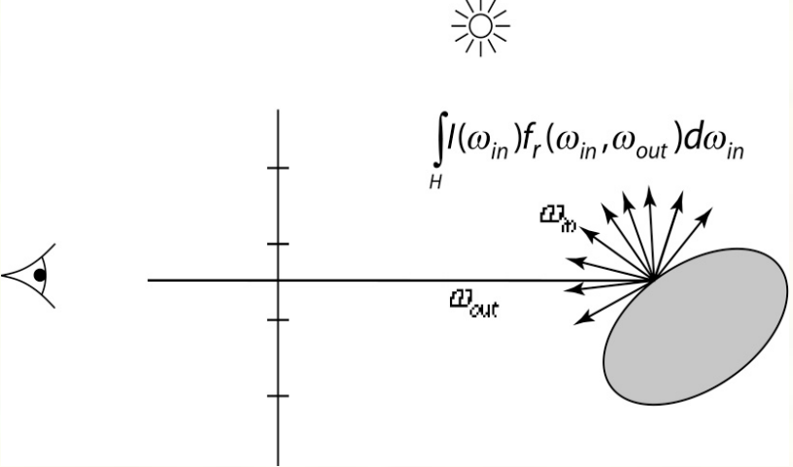
Distributed ray tracing
www.cs.utexas.edu/users/fussell/courses/cs384g-fall2011/lectures/lecture11-Drt.pdf
Notes:
Look so familiar ?

Slide 33

What kind of integrators do we have ?
Week03 assignment
1 ray at the pixel center
1 ray at random location of the pixel
Multiple rays at random locations
Week04 assignment
Multiple rays at random locations + no scattering
Week05 assignment
Multiple rays at random locations + random scattering

Slide 34

Codes and class assignment !
Github : RT-python-week08
https://github.com/KUGA-01418283-Raytracing/RT-python-week08

